Slide 1
Chapter 9: Multiarea OSPF
Instructor Materials
CCNA Routing and Switching
Scaling Networks v6.0
Notes:
Cisco Networking Academy Program
Scaling Networks v6.0
Chapter 9: Multiarea OSPF

Slide 2
Instructor Materials – Chapter 9 Planning Guide
This PowerPoint deck is divided in two parts:
Instructor Planning Guide
Information to help you become familiar with the chapter
Teaching aids
Instructor Class Presentation
Optional slides that you can use in the classroom
Begins on slide # 11
Note: Remove the Planning Guide from this presentation before sharing with anyone.
Notes:
2

Slide 3
Chapter 9: Multiarea OSPF
Scaling Networks v6.0 Planning Guide
Notes:
Cisco Networking Academy Program
Scaling Networks v6.0
Chapter 9: Multiarea OSPF

Slide 4
Chapter 9: Activities
What activities are associated with this chapter?
Page # | Activity Type | Activity Name | Optional?
9.0.1.2 | Class Activity | Leaving on a Jet Plane | Optional
9.1.1.5 | Activity | Identify the Multiarea OSPF Terminology | Recommended
9.1.2.7 | Activity | Identify the OSPF LSA Type | Recommended
9.1.3.3 | Activity | Order the Steps for OSPF Best Path Calculations | Recommended
9.2.1.2 | Syntax Checker | Configuring Multiarea OSPF on R2 & R3 | Recommended
9.2.1.3 | Syntax Checker | Configuring Multiarea OSPFv3 on R2 & R3 | Recommended
9.2.2.2 | Syntax Checker | Verifying Multiarea OSPFv2 Status | Recommended
9.2.2.3 | Syntax Checker | Verifying Multiarea OSPF Routesv2 on R2 and R3 | Recommended
9.2.2.4 | Syntax Checker | Verifying the OSPFv2 LSDB on R2 and R3 | Recommended
The password used in the Packet Tracer activities in this chapter is: PT_ccna5
Notes:
4

Slide 5
Chapter 9: Activities (Cont.)
What activities are associated with this chapter?
Page # | Activity Type | Activity Name | Optional?
9.2.2.6 | Packet Tracer | Configuring Multiarea OSPFv2 | Optional
9.2.2.7 | Packet Tracer | Configuring Multiarea OSPFv3 | Optional
9.2.2.8 | Lab | Configuring Multiarea OSPFv2 | Recommended
9.2.2.9 | Lab | Configuring Multiarea OSPFv3 | Recommended
9.3.1.1 | Class Activity | Digital Trolleys | Optional
The password used in the Packet Tracer activities in this chapter is: PT_ccna5
Notes:
5

Slide 6
Chapter 9: Assessment
Students should complete Chapter 9, “Assessment” after completing Chapter 9.
Quizzes, labs, Packet Tracers and other activities can be used to informally assess student progress.
Notes:
6

Slide 7
Chapter 9: Best Practices
Prior to teaching Chapter 9, the instructor should:
Complete Chapter 9, “Assessment.”
The objectives of this chapter are:
Explain why multiarea OSPF is used.
Explain how multiarea OSPF establishes neighbor adjacencies.
Configure multiarea OSPFv2 and OSPFv3 in a routed network.
Verify multiarea OSPFv2 and OSPFv3 operation.
Notes:
7

Slide 8
Chapter 9: Best Practices (Cont.)
Consider setting up a large OSPF single area network and then adjust the topology to a multiarea network.
Discuss with students the differences between single-area OSPF and multiarea OSPF.
Discuss the advantages of multiarea OSPF.
Make sure the students pay particular attention to the LSA types discussed on pages 9.1.2.2 – 9.1.2.6. These types should be memorized. Compare and contrast the LSA types.
Create the reference topology in 9.2.1.2 and use this to demonstrate the configuration of OSPFv2 and OSPFv3.
Use the same topology to demonstrate all the show commands that can be used to verify OSPFv2 and OSPFv3.
Provide the students with plenty of practice with hands-on labs based on multiarea OSPF configuration in addition to the recommended labs.
Notes:
8

Slide 9
Chapter 9: Additional Help
For additional help with teaching strategies, including lesson plans, analogies for difficult concepts, and discussion topics, visit the CCNA Community at: https://www.netacad.com/group/communities/community-home
Best practices from around the world for teaching CCNA Routing and Switching. https://www.netacad.com/group/communities/ccna
If you have lesson plans or resources that you would like to share, upload them to the CCNA Community in order to help other instructors.
Students can enroll in Introduction to Packet Tracer (self-paced)
Notes:
9

Slide 11
Chapter 9: Multiarea OSPF
CCNA Routing and Switching
Scaling Networks v6.0
Notes:
Cisco Networking Academy Program
Scaling Networks v6.0
Chapter 9: Multiarea OSPF

Slide 12
Chapter 9 - Sections & Objectives
9.1 Multiarea OSPF Operation
Explain how multiarea OSPF operates in a small to medium-sized business network.
Explain why multiarea OSPF is used.
Explain how multiarea OSPFv2 uses link-state advertisements.
Explain how multiarea OSPF establishes neighbor adjacencies.
9.2 Implement Multiarea OSPF
Implement multiarea OSPFv2 and OSPFv3.
Configure multiarea OSPFv2 and OSPFv3 in a routed network.
Verify multiarea OSPFv2 and OSPFv3 operation.
Notes:
12
Cisco Networking Academy Program
Scaling Networks v6.0
Chapter 9: Multiarea OSPF

Slide 13
9.1 Multiarea OSPF Operation
Notes:
9 – Multiarea OSPF
9.1 – Multiarea OSPF Operation

Slide 14
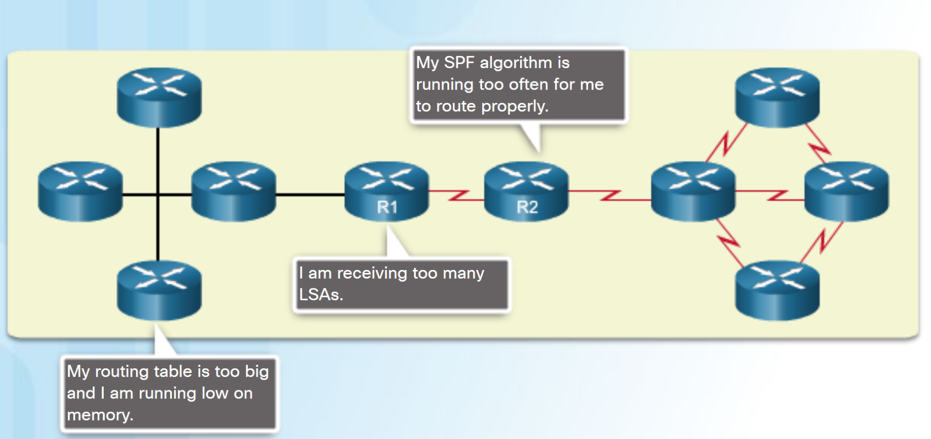
Why Multiarea OSPF? Single-Area OSPF
Issues in a large single area OSPF:
Large routing table
Large link-state database (LSDB)
Frequent SPF algorithm calculations
To make OSPF more efficient and scalable, OSPF supports hierarchical routing using areas.
Notes:
9.1 – Multiarea OSPF Operation
9.1.1 – Why Multiarea OSPF?
9.1.1.1 – Single-Area OSPF

Slide 15
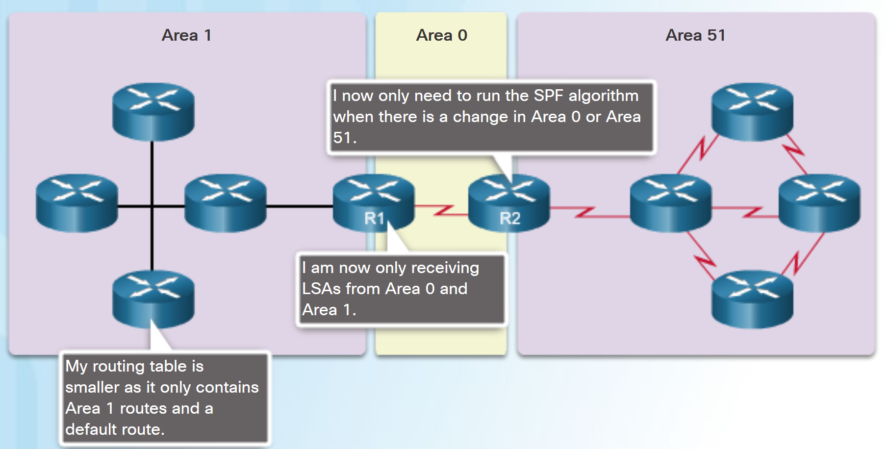
Why Multiarea OSPF? Multiarea OSPF
Multiarea OSPF:
Large OSPF area is divided into smaller areas.
Reduces processing and memory overhead.
Requires a hierarchical network design.
The main area is the backbone area (area 0) and all other areas connect to it.
Advantages of Multiarea OSPF:
Smaller routing tables - Fewer routing table entries as network addresses can be summarized between areas.
Reduced link-state update overhead.
Reduced frequency of SPF calculations.
Notes:
9.1 – Multiarea OSPF Operation
9.1.1 – Why Multiarea OSPF?
9.1.1.2 – Multiarea OSPF

Slide 16
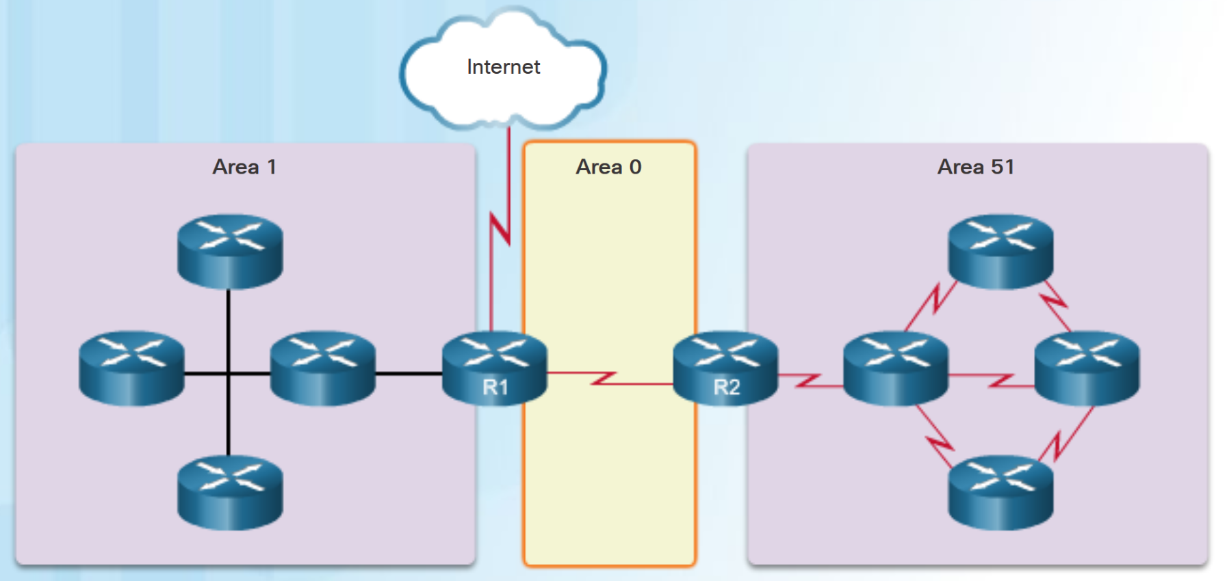
Why Multiarea OSPF? OSPF Two-Layer Area Hierarchy
Multiarea OSPF is implemented in a two-layer area hierarchy.
Backbone (Transit) area - An OSPF area whose primary function is the fast and efficient movement of IP packets:
Interconnects with other OSPF area types.
Also called OSPF area 0.
Regular (nonbackbone) area - Connects users and resources:
Usually set up along functional or geographical groupings
All traffic from other areas must cross a transit area.
Notes:
9.1 – Multiarea OSPF Operation
9.1.1 – Why Multiarea OSPF?
9.1.1.3 – OSPF Two-Layer Area Hierarchy

Slide 17
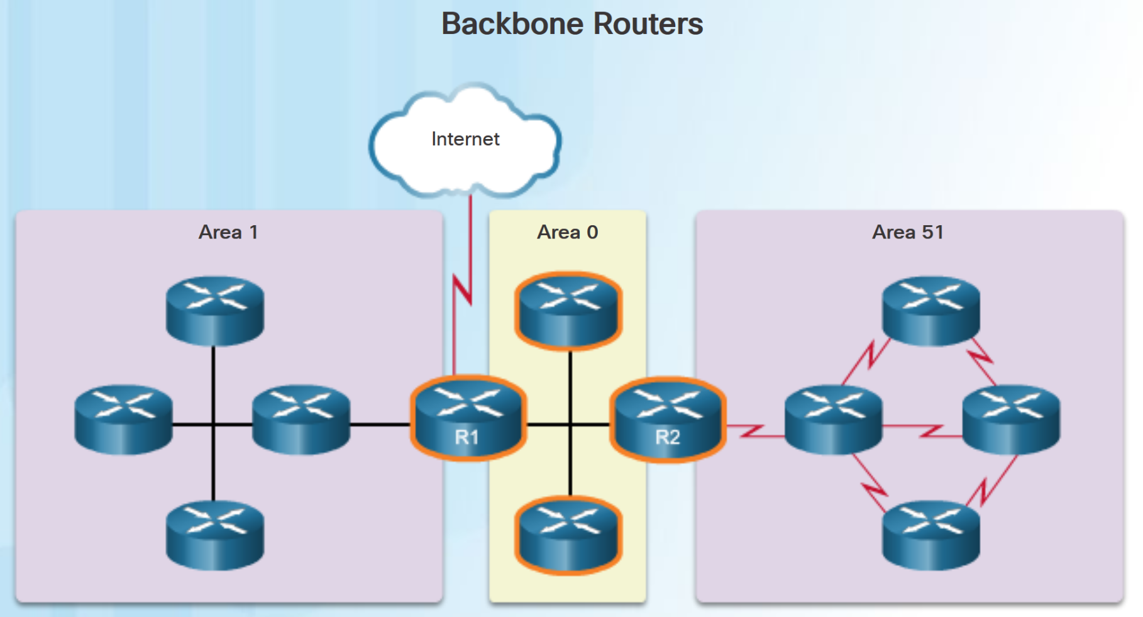
Why Multiarea OSPF? Types of OSPF Routers
There are four different types of OSPF routers:
Internal router –A router that has all of its interfaces in the same area.
Backbone router - A router in the backbone area. The backbone area is set to area 0
Area Border Router (ABR) – A router that has interfaces attached to multiple areas.
Autonomous System Boundary Router (ASBR) – A router that has at least one interface attached to an external internetwork.
A router can be classified as more than one router type.
Notes:
9.1 – Multiarea OSPF Operation
9.1.1 – Why Multiarea OSPF?
9.1.1.4 – Types of OSPF Routers

Slide 18
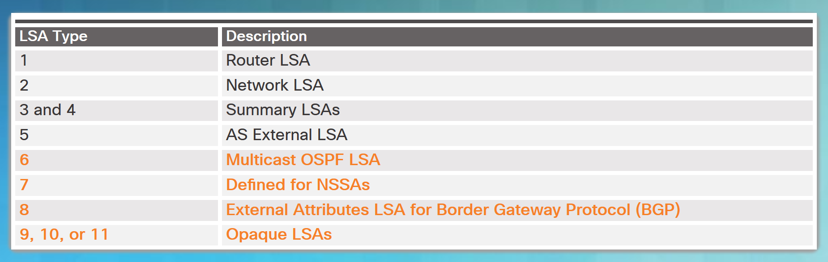
Multiarea OSPF LSA Operation OSPF LSA Types
LSAs individually act as database records and provide specific OSPF network details.
LSAs in combination describe the entire topology of an OSPF network or area.
Any implementation of multiarea OSPF must support the first five LSAs
Notes:
9.1 – Multiarea OSPF Operation
9.1.2 – Multiarea OSPF LSA Operation
9.1.2.1 – OSPF LSA Types

Slide 19
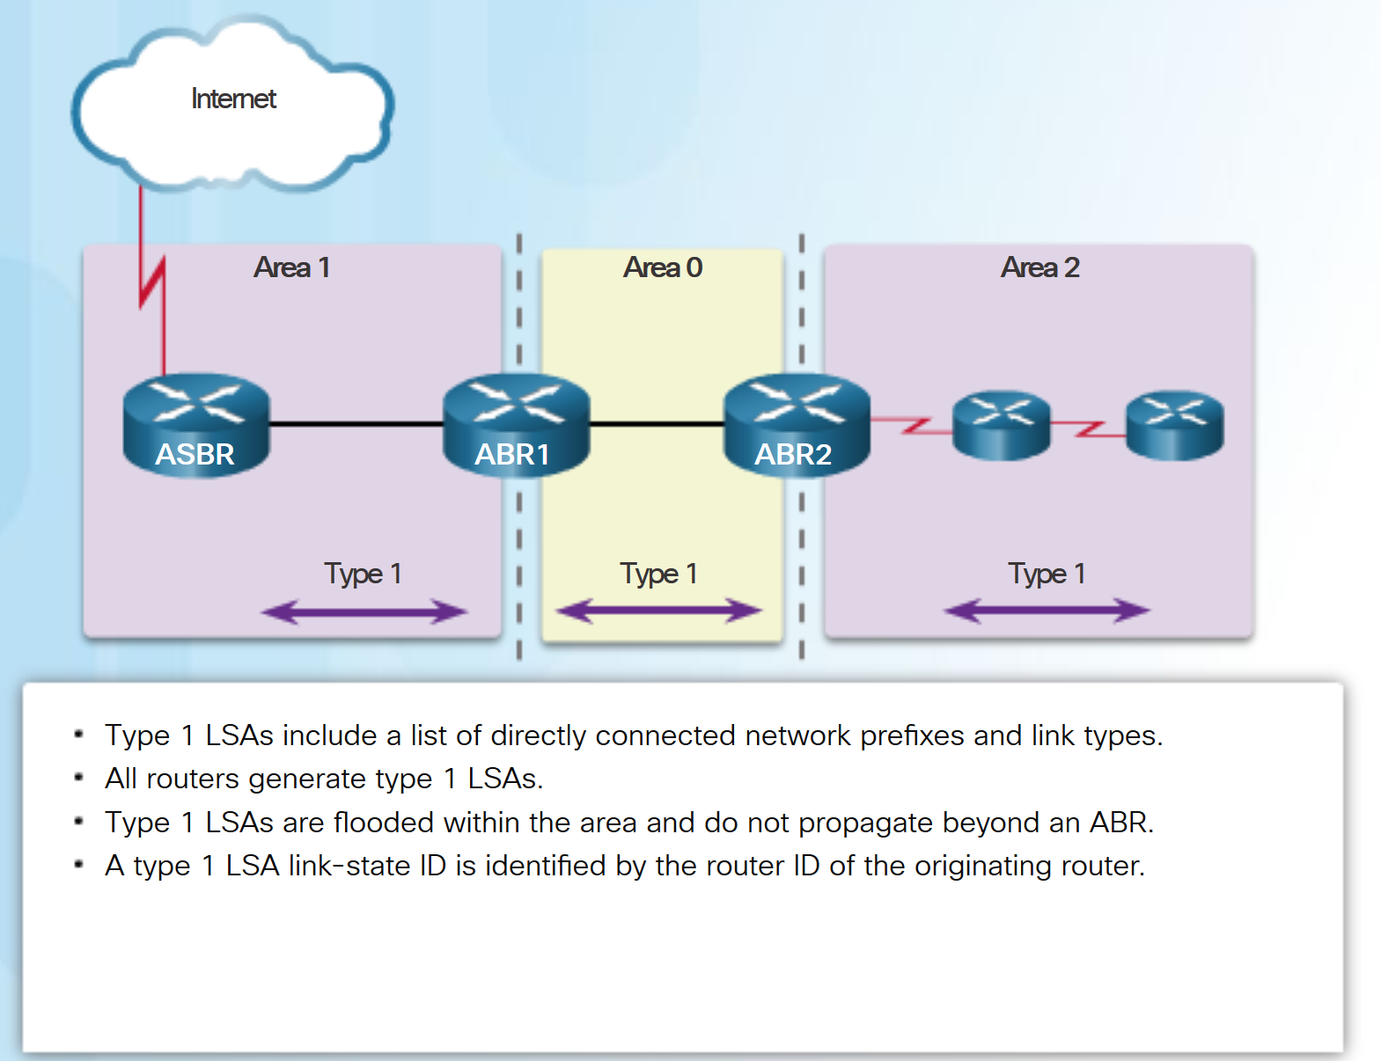
Multiarea OSPF LSA Operation OSPF LSA Type 1
Routers advertise their directly connected OSPF-enabled links in a type 1 LSA .
Type 1 LSAs are also referred to as router link entries.
Type 1 LSAs are flooded only within the area in which they originated.
ABRs advertise the networks learned from the type 1 LSAs to other areas as type 3 LSAs.
The type 1 LSA link ID is identified by the router ID of the originating router.
Notes:
9.1 – Multiarea OSPF Operation
9.1.2 – Multiarea OSPF LSA Operation
9.1.2.2 – OSPF LSA Type 1

Slide 20
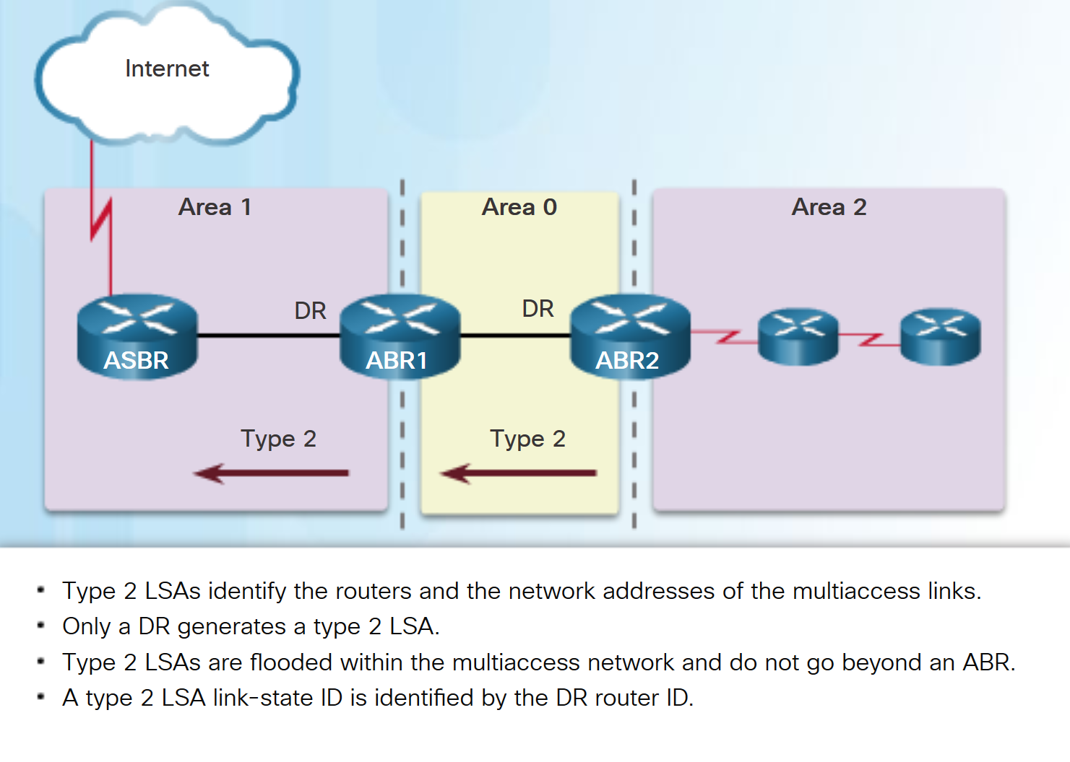
Multiarea OSPF LSA Operation OSPF LSA Type 2
Type 2 LSAs have the following characteristics:
Only found on multiaccess and nonbroadcast multiaccess (NBMA) networks
Contain the router ID and IP address of the DR, along with the router ID of all other routers on the multiaccess segment
Give other routers information about multiaccess networks within the same area
Not forwarded outside of an area
Also referred to as network link entries
Link-state ID is DR router ID
Notes:
9.1 – Multiarea OSPF Operation
9.1.2 – Multiarea OSPF LSA Operation
9.1.2.3 – OSPF LSA Type 2

Slide 21
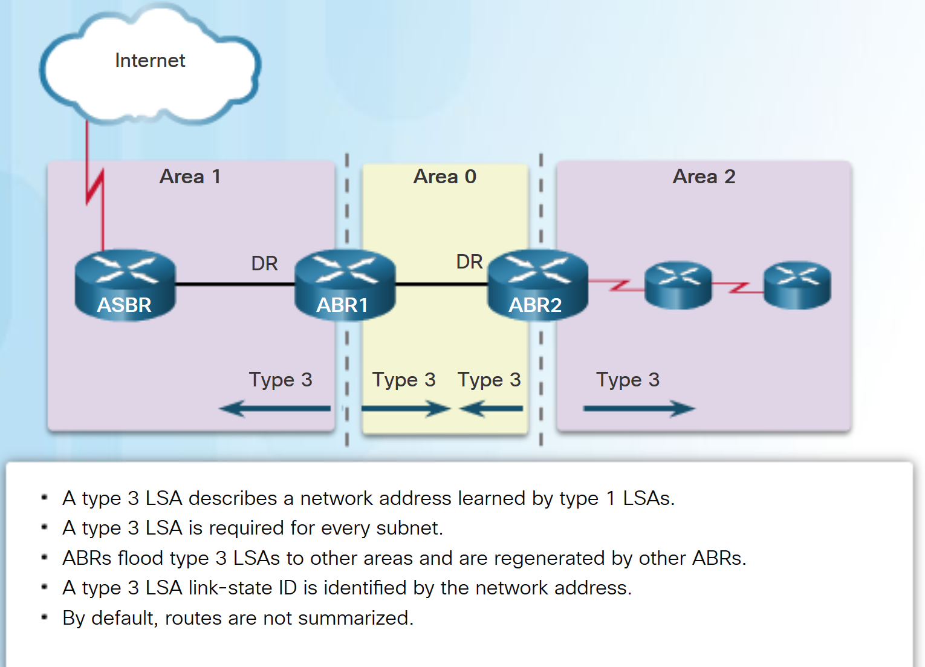
Multiarea OSPF LSA Operation OSPF LSA Type 3
Type 3 LSAs have the following characteristics:
They are used by ABRs to advertise networks from other areas.
The ABR creates a type 3 LSA for each of its learned OSPF networks.
ABRs flood type 3 LSAs from one area to other areas.
To reduce impact of flooding in a large OSPF deployment, configuration of manual route summarization on the ABR is recommended.
The link-state ID is set to the network address.
Notes:
9.1 – Multiarea OSPF Operation
9.1.2 – Multiarea OSPF LSA Operation
9.1.2.4 – OSPF LSA Type 3

Slide 22
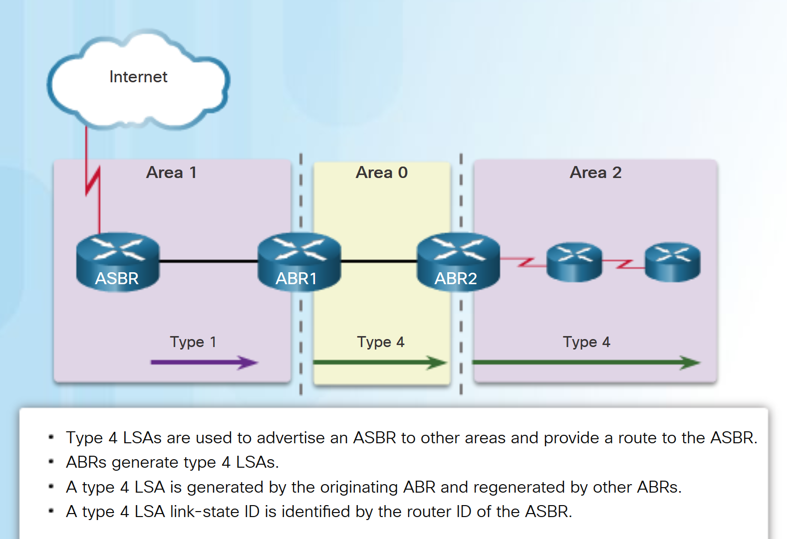
Multiarea OSPF LSA Operation OSPF LSA Type 4
Type 4 LSAs have the following characteristics:
They identify an ASBR and provide a route to it.
They are generated by an ABR only when an ASBR exists within an area.
They are flooded to other areas by ABRs.
The link-state ID is set to the ASBR router ID.
Notes:
9.1 – Multiarea OSPF Operation
9.1.2 – Multiarea OSPF LSA Operation
9.1.2.5 – OSPF LSA Type 4

Slide 23
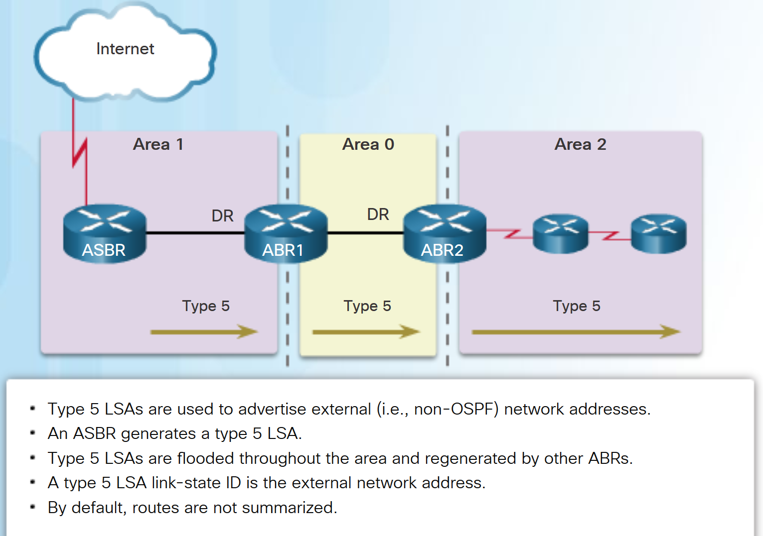
Multiarea OSPF LSA Operation OSPF LSA Type 5
Type 5 LSAs have the following characteristics:
They advertise external routes, also referred to as external LSA entries.
They are originated by the ASBR and flooded to the entire routing domain.
The link-state ID is the external network number.
Notes:
9.1 – Multiarea OSPF Operation
9.1.2 – Multiarea OSPF LSA Operation
9.1.2.6 – OSPF LSA Type 5

Slide 24
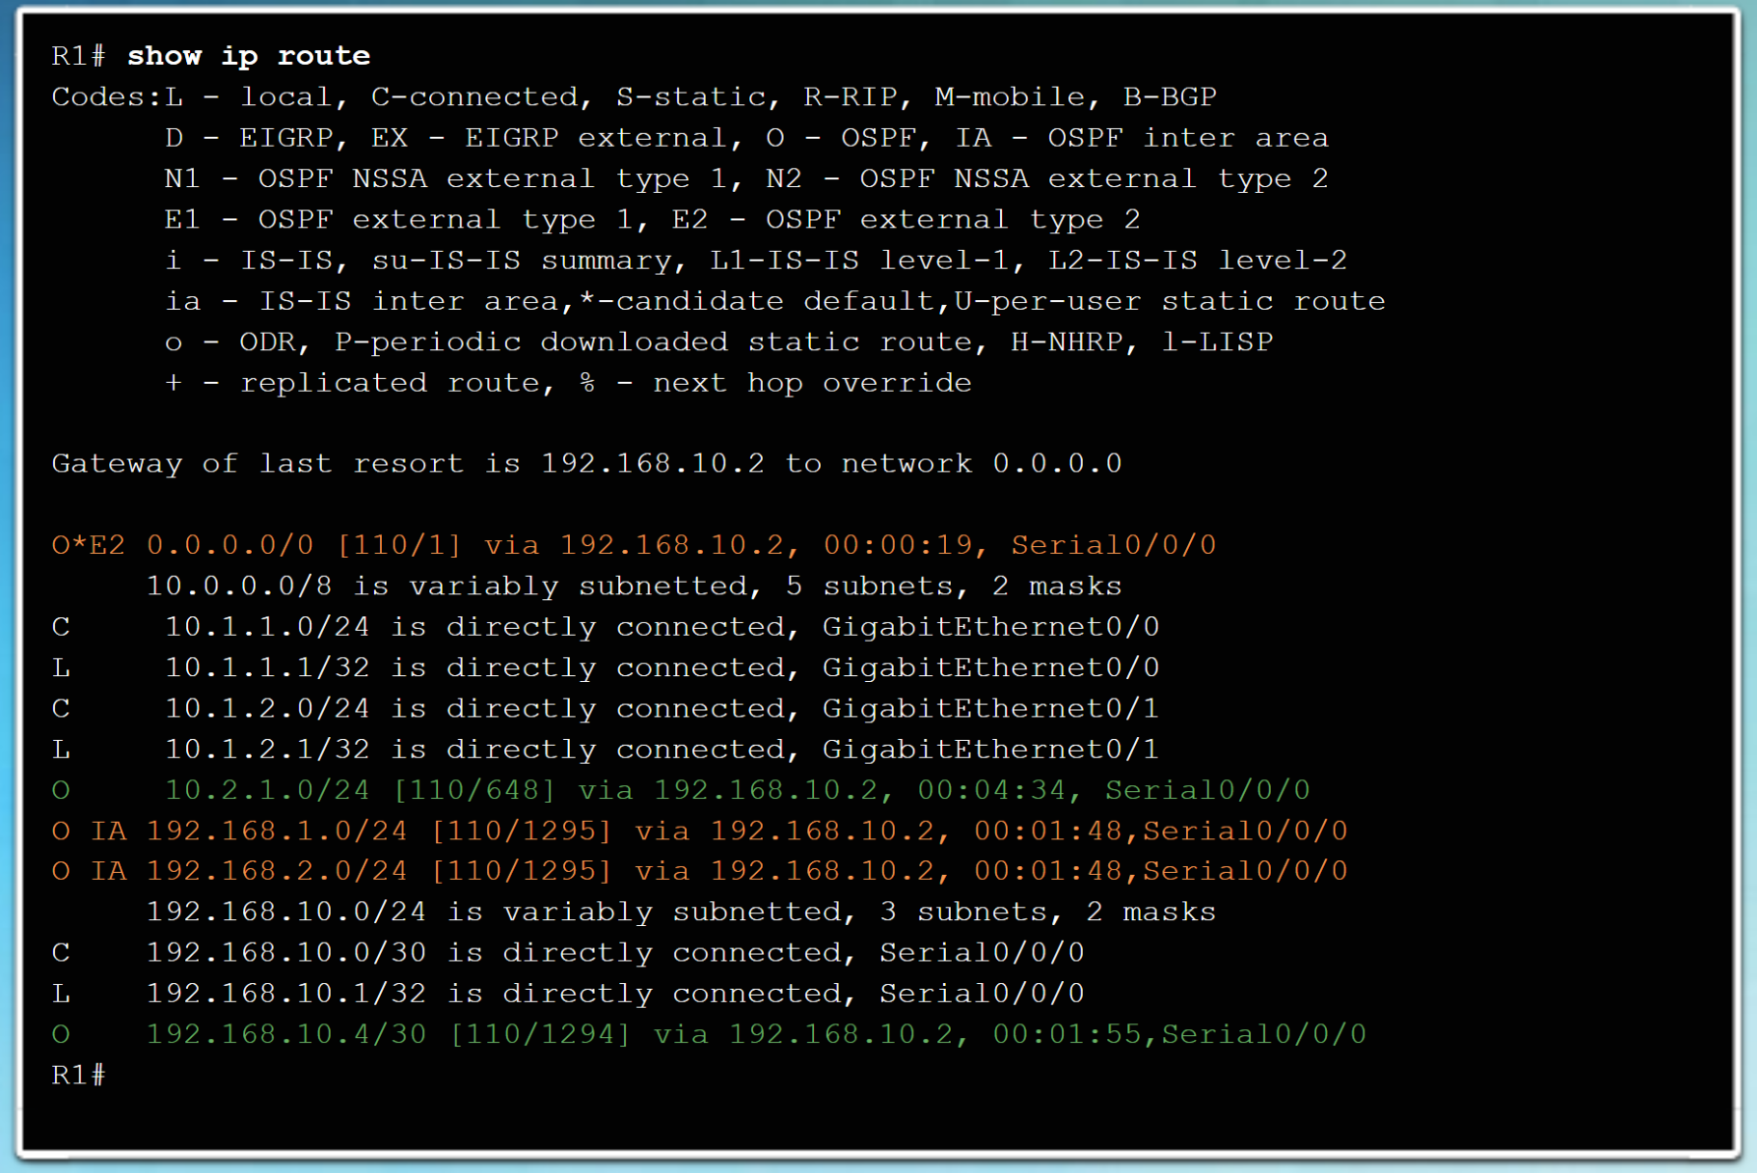
OSPF Routing Table and Types of Routes OSPF Routing Table Entries
OSPF routes in an IPv4 routing table are identified using the following descriptors:
O - The routing table reflects the link-state information with a designation of O, meaning that the route is intra-area
O IA - Summary LSAs appear in the routing table as IA (interarea routes).
O E1 or O E2 - External LSAs appear in the routing table marked as external type 1 (E1) or external type 2 (E2) routes.
Notes:
9.1 – Multiarea OSPF Operation
9.1.3 –OSPF Routing Table and Types of Routes
9.1.3.1 – OSPF Routing Table Entries

Slide 25
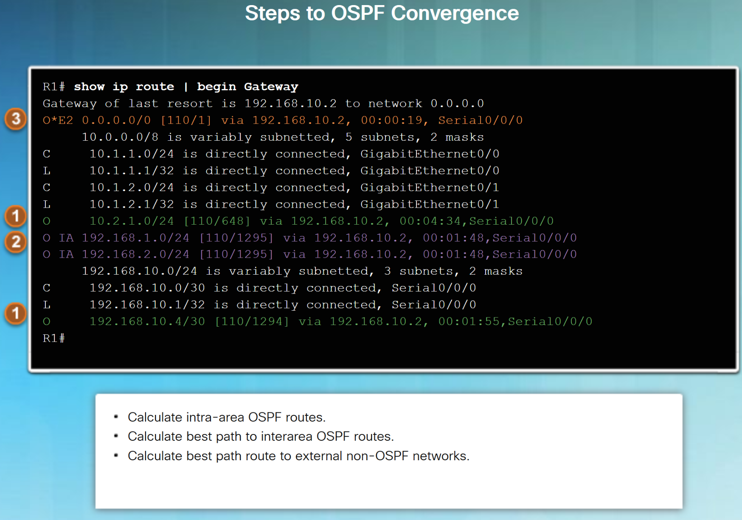
OSPF Routing Table and Types of Routes OSPF Route Calculation
The order in which the best paths are calculated is as follows:
All routers calculate the best path or paths to destinations within their area (intra-area). These are the type 1 and type 2 LSAs – O.
All routers calculate the best path or paths to the other areas within the internetwork. Type 3 LSAs - O IA.
All routers calculate the best path or paths to the external autonomous system (type 5) destinations - O E1 or an O E2 .
Notes:
9.1 – Multiarea OSPF Operation
9.1.3 –OSPF Routing Table and Types of Routes
9.1.3.2 – OSPF Route Calculation

Slide 26
9.2 Configuring Multiarea OSPF
Notes:
9 – Multiarea OSPF
9.2 – Configuring Multiarea OSPF

Slide 27
Configuring Multiarea OSPF Implementing Multiarea OSPF
There are 4 steps to implementing multiarea OSPF:
Step 1. Gather the network requirements and parameters
Step 2. Define the OSPF parameters
Single area or multiarea OSPF?
IP addressing plan
OSPF areas
Network topology
Step 3. Configure the multiarea OSPF implementation based on the parameters.
Step 4. Verify the multiarea OSPF implementation
Notes:
9.2 – Configuring Multiarea OSPF
9.2.1 – Configuring Multiarea OSPF
9.2.1.1 – Implementing Multiarea OSPF

Slide 28
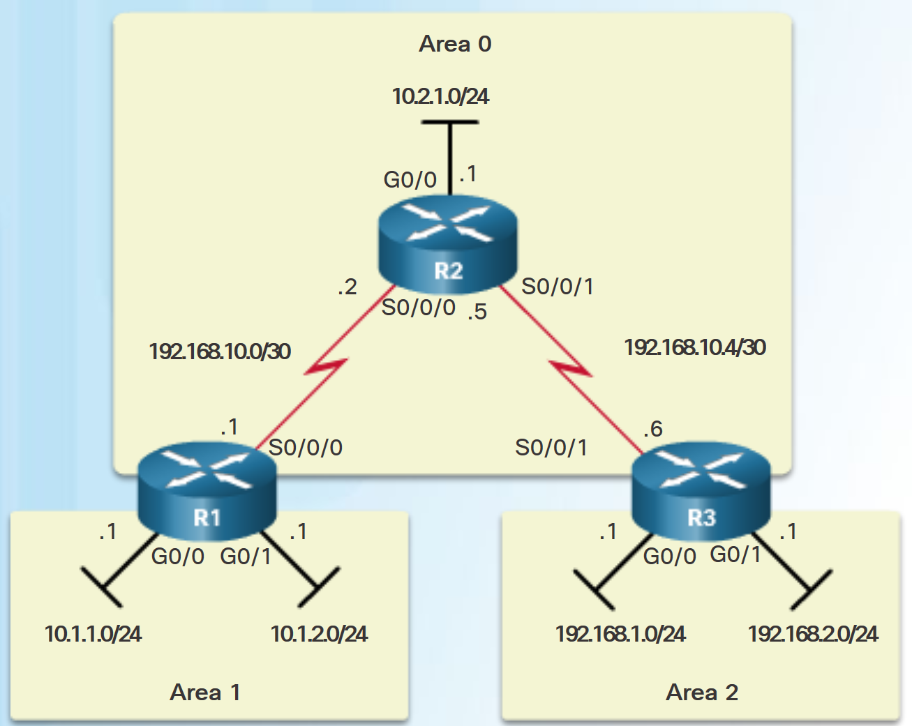
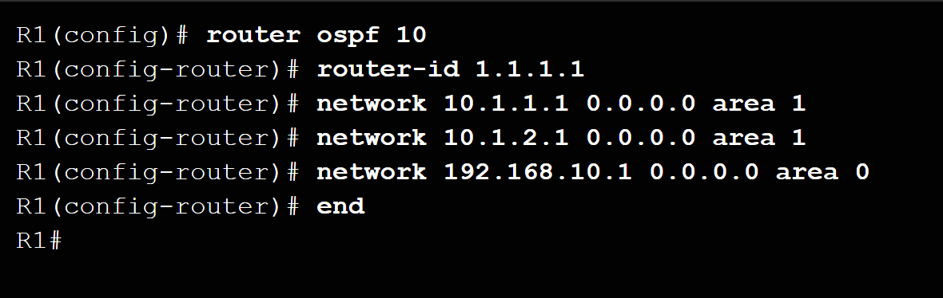
Configuring Multiarea OSPF Configuring Multiarea OSPFv2
There are no special commands to implement multiarea OSPFv2.
A router becomes an ABR when it has two network statements in different areas.
R1 is an ABR because it has interfaces in area 1 and an interface in area 0.
Notes:
9.2 – Configuring Multiarea OSPF
9.2.1 – Configuring Multiarea OSPF
9.2.1.2 – Configuring Multiarea OSPFv2

Slide 29
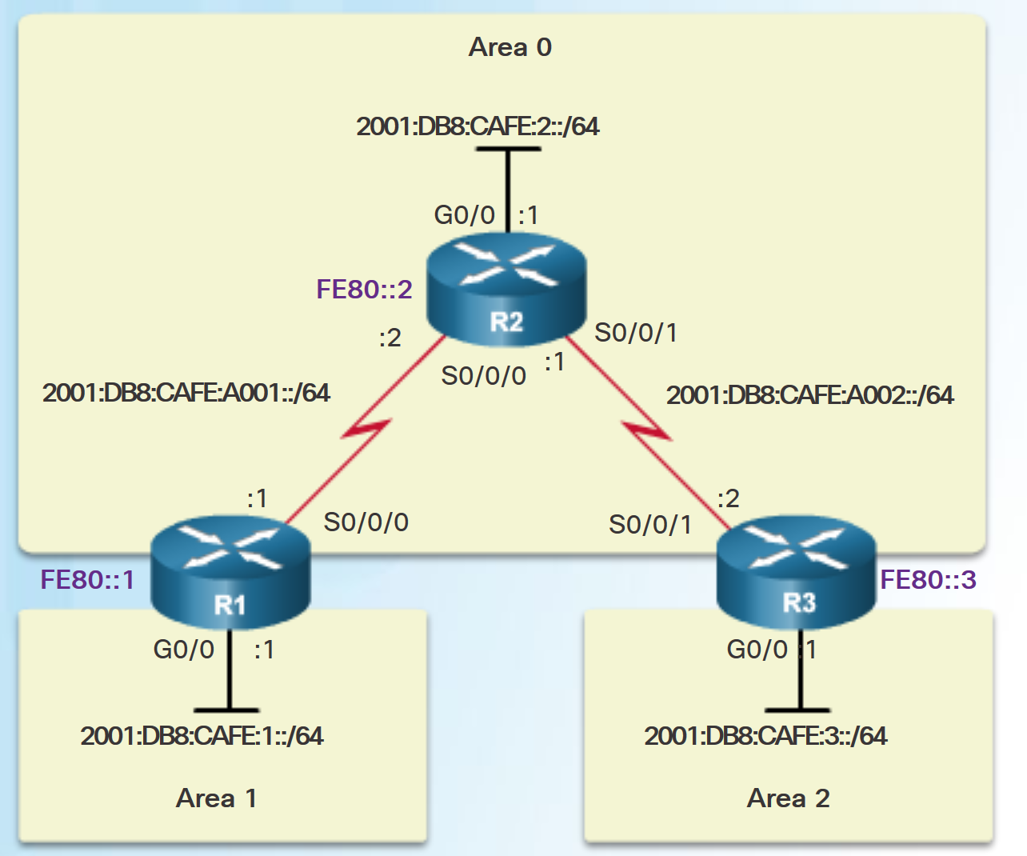
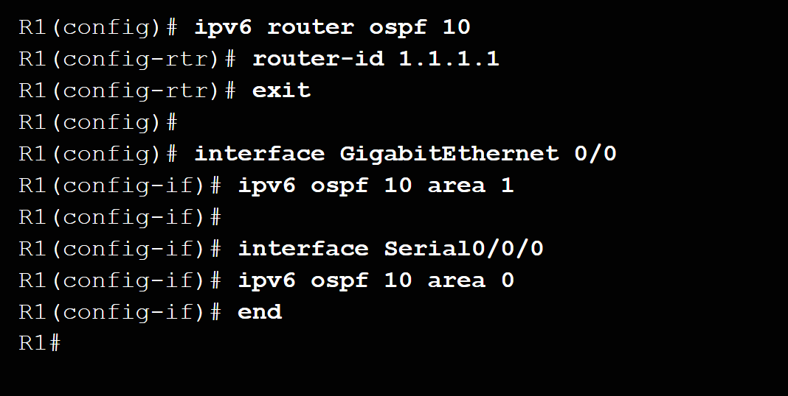
Configuring Multiarea OSPF Configuring Multiarea OSPFv3
There are no special commands required to implement multiarea OSPFv3.
A router becomes an ABR when it has two interfaces in different areas.
Notes:
9.2 – Configuring Multiarea OSPF
9.2.1 – Configuring Multiarea OSPF
9.2.1.3 – Configuring Multiarea OSPFv3

Slide 30
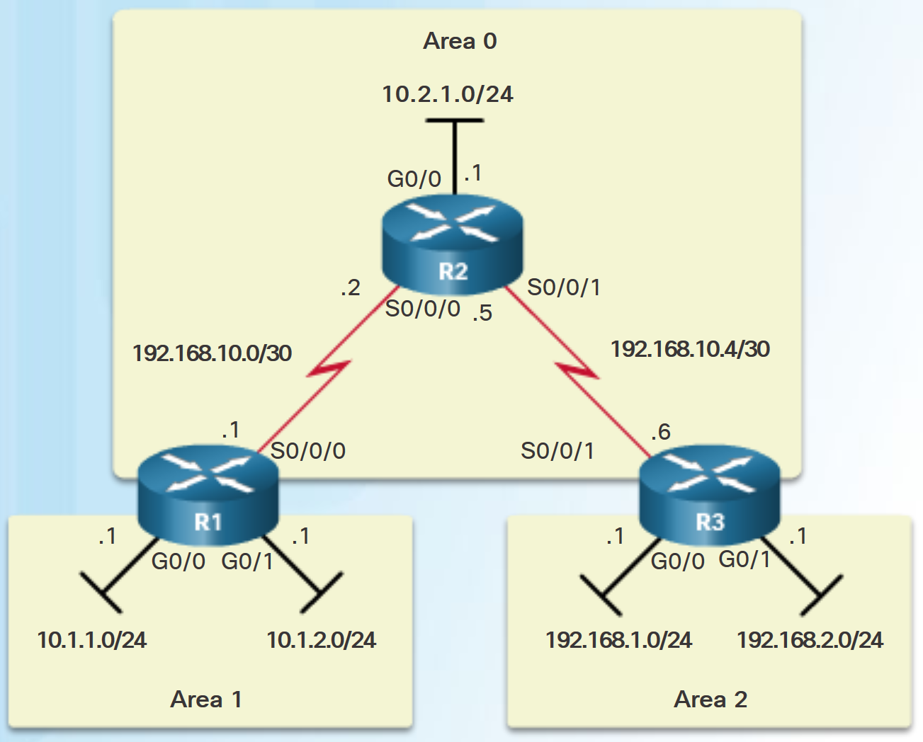
Verifying Multiarea OSPF Verifying Multiarea OSPFv2
Commands to verify multiarea OSPFv2
show ip ospf neighbor
show ip ospf
show ip ospf interface
Show ip protocols
show ip ospf interface brief
show ip route ospf
show ip ospf database
Note: For the equivalent OSPFv3 command, simply substitute ipv6 for ip.
Notes:
9.2 – Configuring Multiarea OSPF
9.2.2 – Verifying Multiarea OSPF
9.2.2.1 – Verifying Multiarea OSPFv2

Slide 31
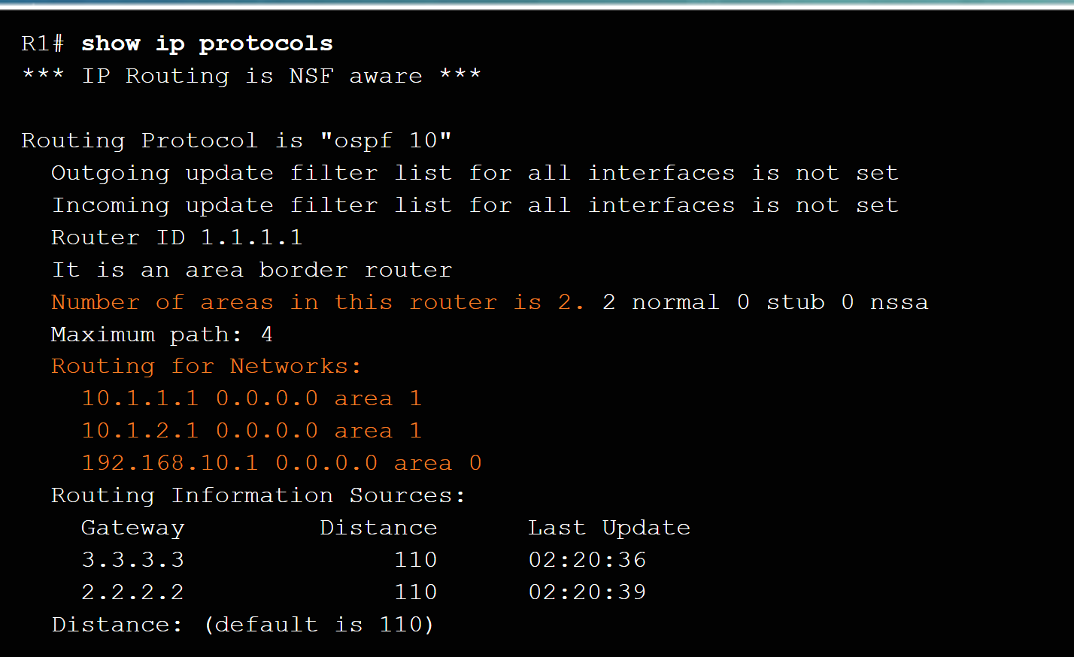
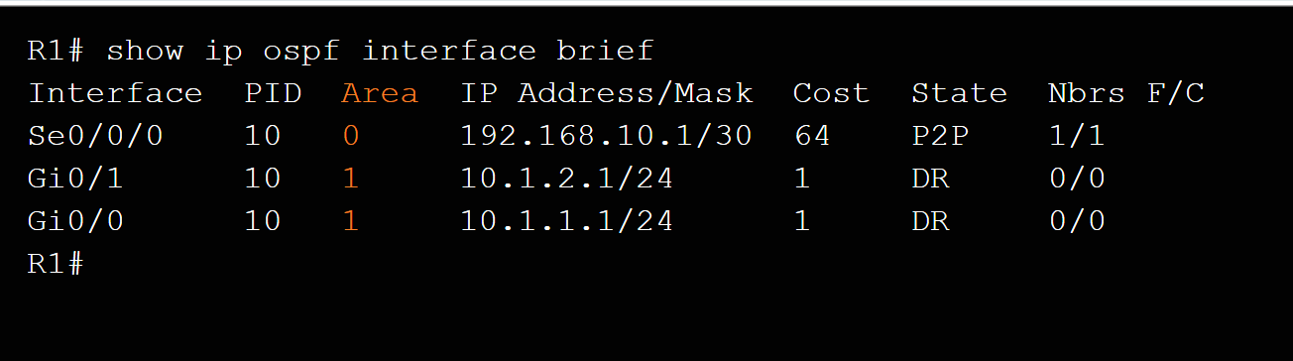
Verifying Multiarea OSPF Verify General Multiarea OSPFv2 Settings
Use the show ip protocols command to verify the OSPFv2 status.
Lists routing protocols configured on router, number of areas, router ID and networks included in routing protocol.
Use the show ip ospf interface brief command to display OSPFv2-related information for OSPFv2-enabled interfaces.
Lists the OSPFv2 process ID, area that the interfaces are in, and interface cost.
Notes:
9.2 – Configuring Multiarea OSPF
9.2.2 – Verifying Multiarea OSPF
9.2.2.2 – Verify General Multiarea OSPFv2 Settings

Slide 32
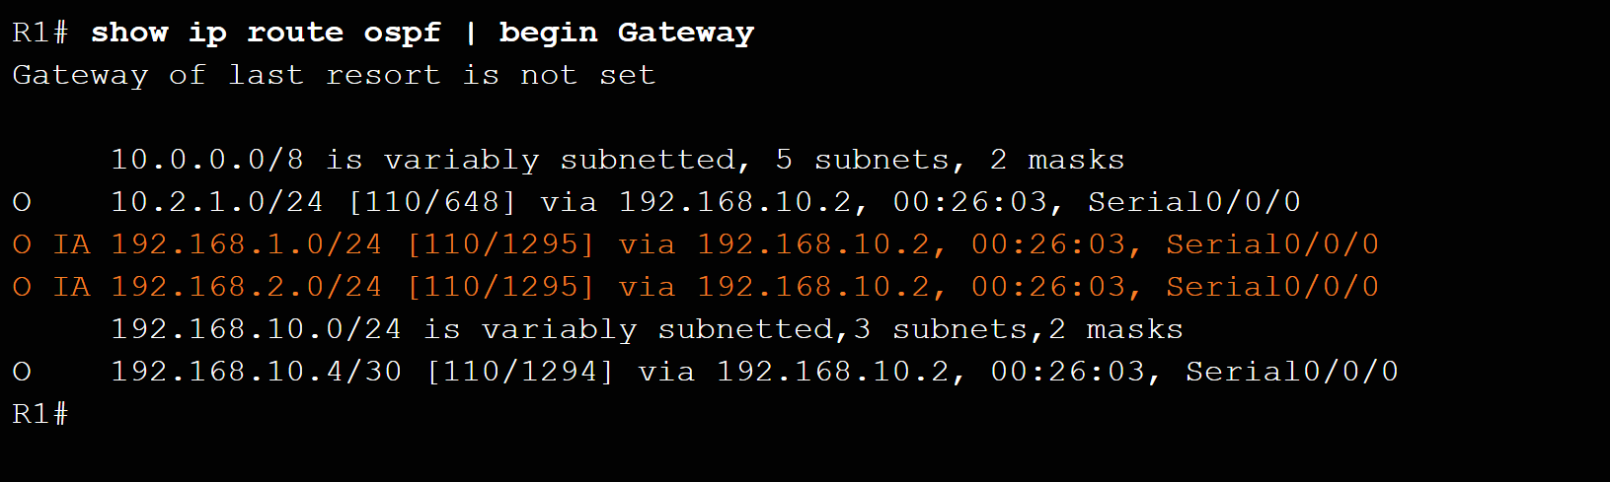
Verifying Multiarea OSPF Verify the OSPFv2 Routes
Use the show ip route ospf command to verify the muliarea OSPFv2 configuration..
O represents OSPFv2 routes and IA represents interarea, which means that the route originated from another area.
Notes:
9.2 – Configuring Multiarea OSPF
9.2.2 – Verifying Multiarea OSPF
9.2.2.3 – Verify the OSPFv2 Routes

Slide 33
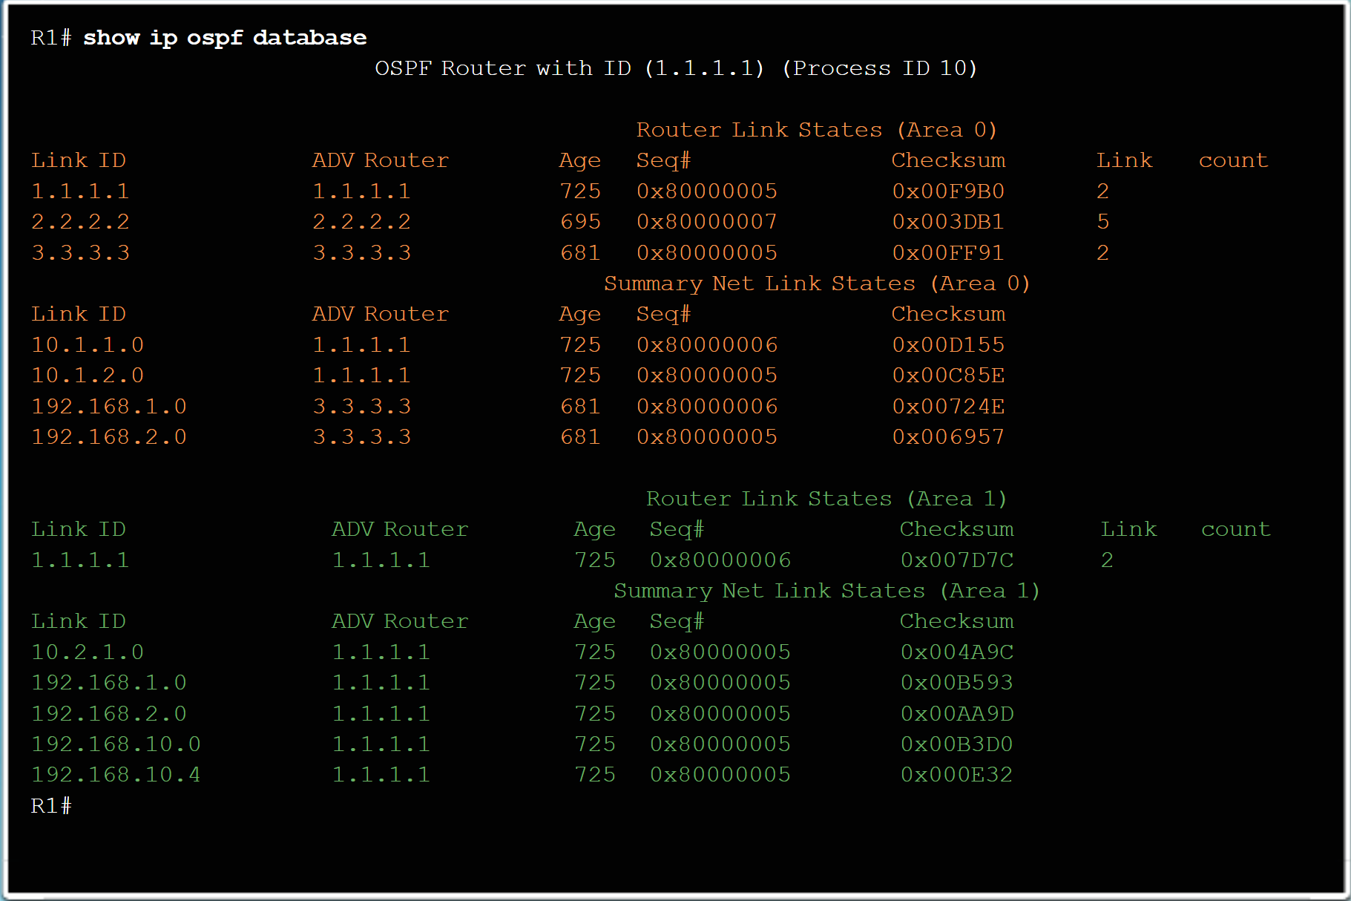
Verifying Multiarea OSPF Verify the Multiarea OSPFv2 LSDB
Use the show ip ospf database command to verify the contents of the OSPFv2 LSDB.
Notes:
9.2 – Configuring Multiarea OSPF
9.2.2 – Verifying Multiarea OSPF
9.2.2.4 – Verify the Multiarea OSPFv2 LSDB

Slide 34
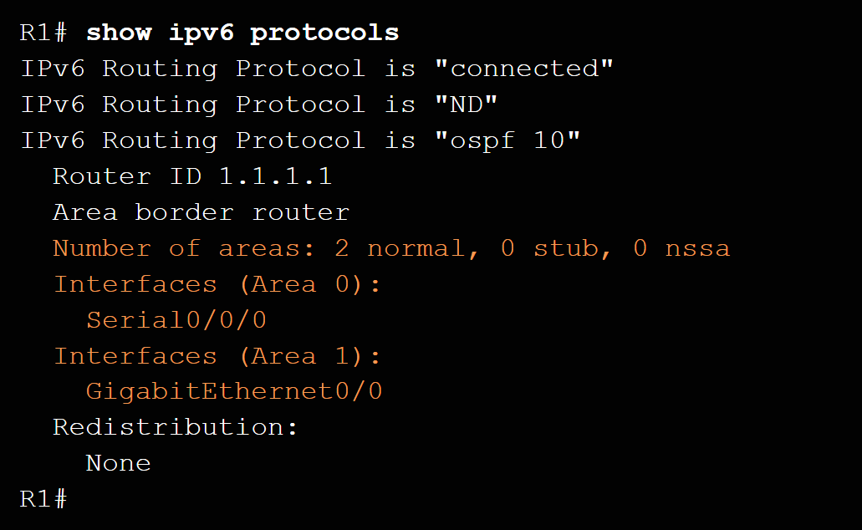
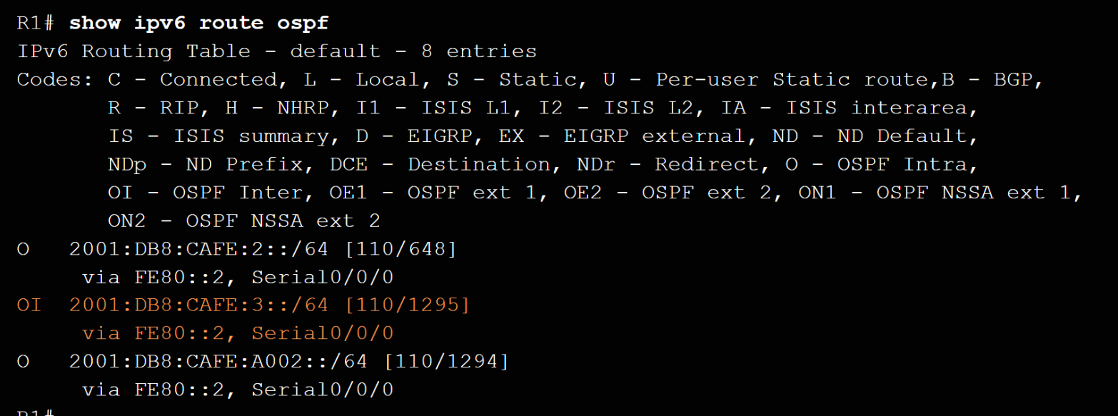
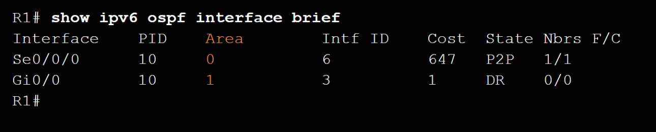
Verifying Multiarea OSPF Verify Multiarea OSPFv3
Use the show ipv6 protocols command to verifyOSPFv3.
Use the show ipv6 interface brief to verify the OSPFv3-enabled interfaces and the area to which they belong.
Use show ipv6 route ospf to display the routing table.
Use show ipv6 ospf database to display the contents of the LSDB.
Notes:
9.2 – Configuring Multiarea OSPF
9.2.2 – Verifying Multiarea OSPF
9.2.2.5 – Verify Multiarea OSPFv3

Slide 35
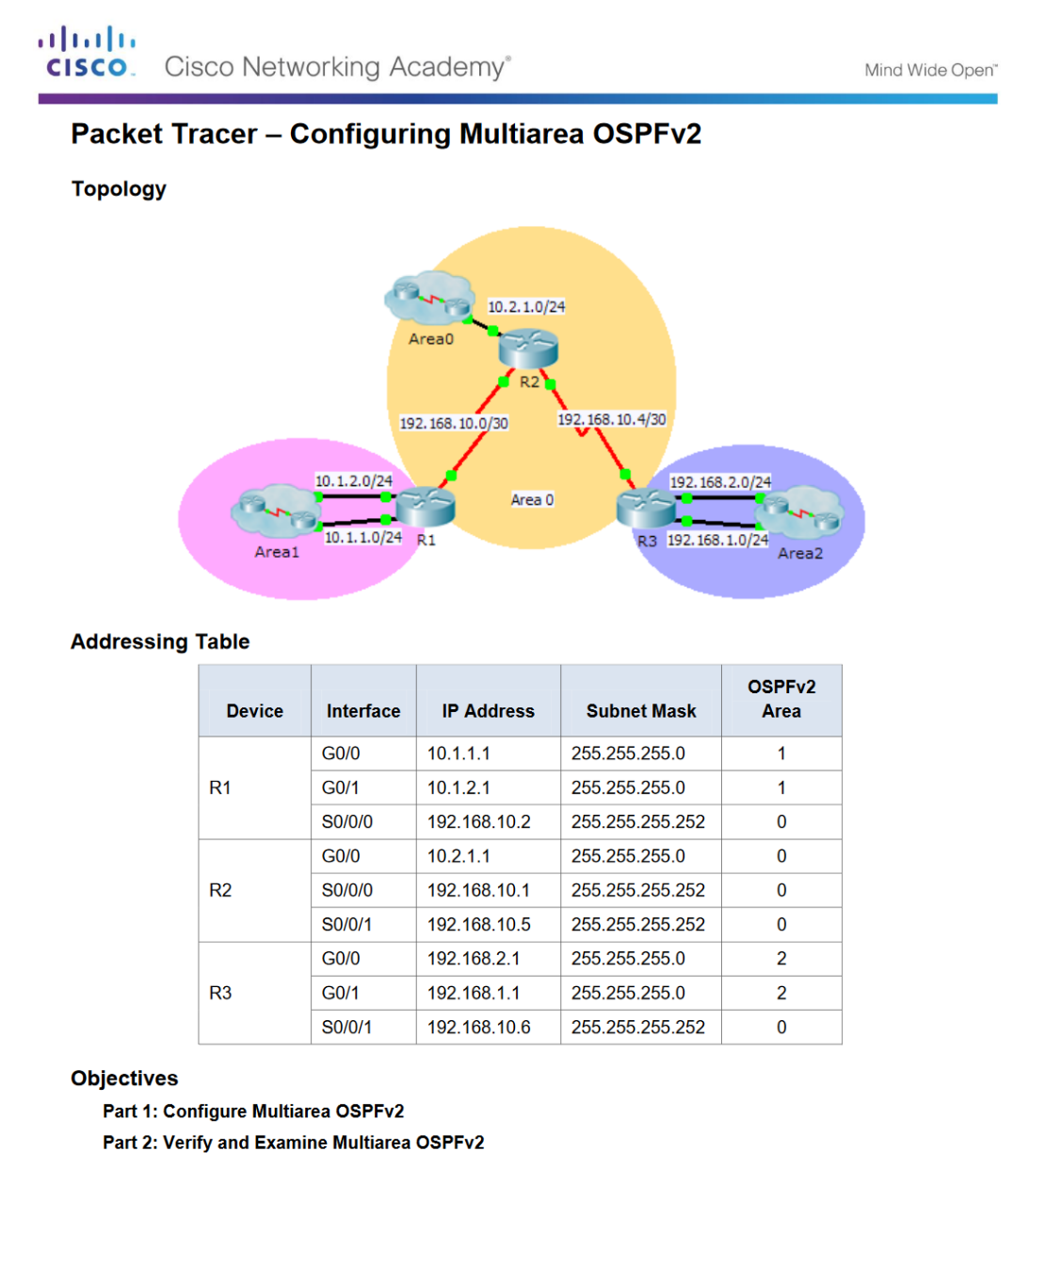
Verifying Multiarea OSPF Packet Tracer - Configuring Multiarea OSPFv2
Notes:
9.2 – Configuring Multiarea OSPF
9.2.2 – Verifying Multiarea OSPF
9.2.2.6 – Packet Tracer - Configuring Multiarea OSPFv2

Slide 36
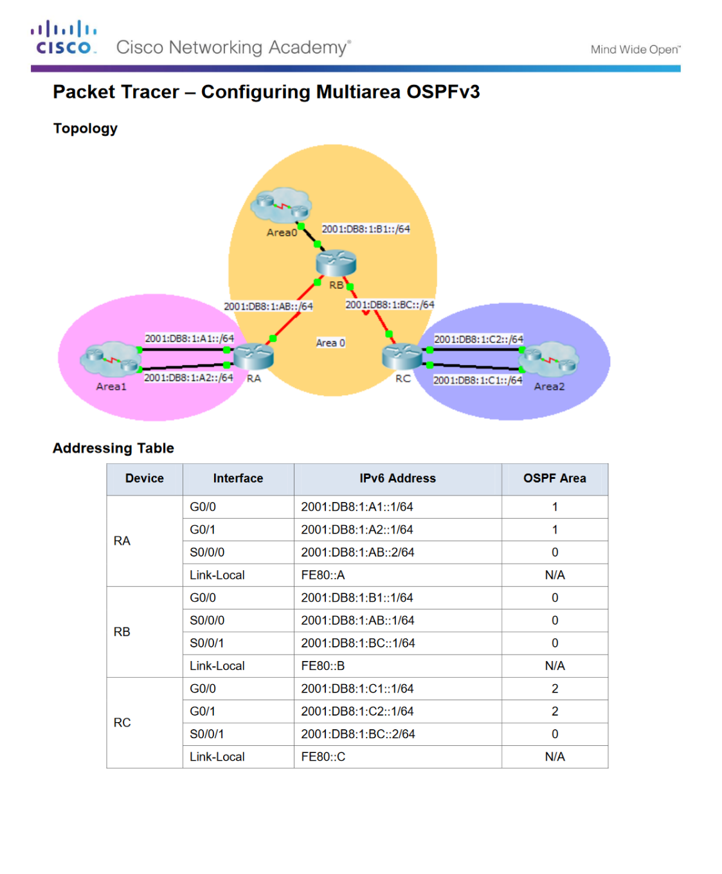
Verifying Multiarea OSPF Packet Tracer - Configuring Multiarea OSPFv3
Notes:
9.2 – Configuring Multiarea OSPF
9.2.2 – Verifying Multiarea OSPF
9.2.2.7 – Packet Tracer - Configuring Multiarea OSPFv3

Slide 37
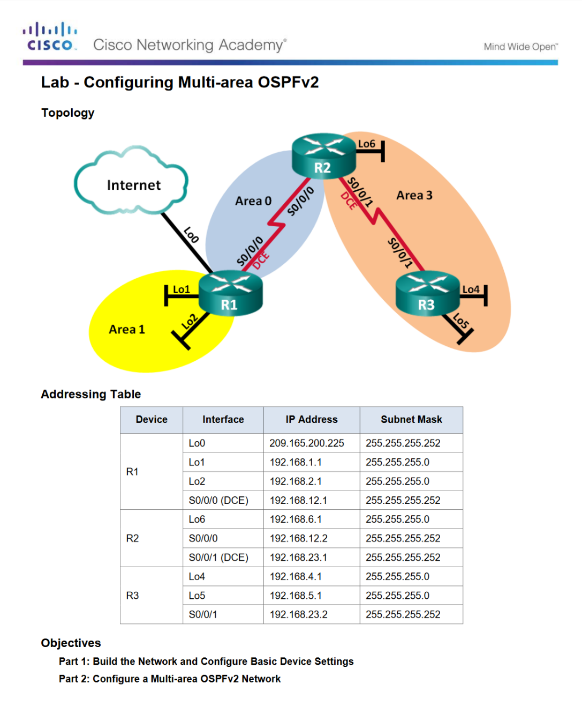
Verifying Multiarea OSPF Lab - Configuring Multiarea OSPFv2
Notes:
9.2 – Configuring Multiarea OSPF
9.2.2 – Verifying Multiarea OSPF
9.2.2.8 – Lab - Configuring Multi-area OSPFv2

Slide 38
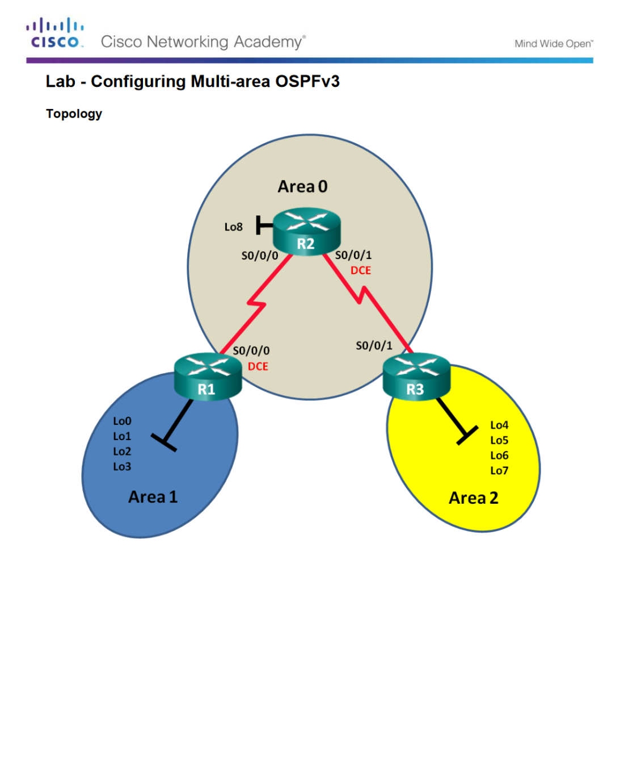
Verifying Multiarea OSPF Lab - Configuring Multiarea OSPFv3
Notes:
9.2 – Configuring Multiarea OSPF
9.2.2 – Verifying Multiarea OSPF
9.2.2.9 – Lab - Configuring Multi-area OSPFv3

Slide 39
9.3 Chapter Summary
Notes:
9 – Multiarea OSPF
9.3 – Summary

Slide 40
Conclusion Chapter 9: Multiarea OSPF
Explain how multiarea OSPF operates in a small to medium-sized business network.
Implement multiarea OSPFv2 and OSPFv3.
Notes:
9.3 – Summary
9.3.1 – Conclusion
9.3.1.2 – Chapter 9: Multiarea OSPF

Slide 41
Chapter 5: Dynamic Routing New Terms and Commands
Internal router Backbone router Autonomous System Boundary Router (ASBR) route redistribution LSA Type 1 LSA Type 2 LSA Type 3 LSA Type 4 LSA Type 5
Notes:
New Terms and Commands

